Slide 1



NRLYZE
CodeZen
Alka Valiparambil Narendran
Grace Amole
Tamanna Rahaman
Thushari Pahalage Dona

Slide 2
NRLYZE
The main objective of the project is to focus on standardization in order to apply machine based analytics on large amounts of data.

Slide 3
What is Standardisation?
“Data standardisation is to make sure that data is stored in the same format, has the same structure and uses the same terminology”
Notes:
Data cleansing and data standardization often get mixed up, but they serve different purposes. Cleansing fixes errors—removing duplicates, correcting typos, and ensuring accuracy. Standardization ensures that the format is consistent across the board.

Slide 4
$ 12.9 million
Organizations per year on average
Notes:
artner estimates that every year, poor data quality costs organizations an average of $12.9 million.

Slide 5
$ 110 million
$ 4.2 million
Unity Software
Notes:
n 2022, Unity Software reported a loss of $110 million in revenue and $4.2 billion in its market cap“Consequences of ingesting bad data from a large customer,

Slide 6
Uk & Ireland Air Traffic
Notes:
More recently, a data incident caused huge disruption to U.K. and Ireland air traffic. It is reported that over 2,000 flights were canceled,

Slide 7


Slide 8
Our
Solution
A web app that:
automates standardization, enrichment, and visualization of raw data, transforming it into actionable insights with just a single upload
Notes:
Alka
standardization, enrichment, and visualization of raw data, transforming it into actionable insights with just a single upload

Slide 9




Key Features
Automation
Data Enrichment
Handles file parsing, cleaning, and integration in one go.
Combines weather data for richer insights
Visualization
Ease of Use
visualizations for quick insights
Simple upload/download functionality.
Notes:
Key Features
Data enrichment is the process of combining first party data from internal sources with disparate data from other internal systems or third party data from external sources
Automation:
Handles file parsing, cleaning, and integration in one go.
Data Enrichment:
Combines weather data for richer insights.
Visualization:
Interactive visualizations for quick insights.
Ease of Use:
Simple upload/download functionality.

Slide 10











Workflow Diagram
Weather Data Integration
Analytics
File Upload
Data Cleaning
Download
Notes:
Alka

Slide 11
Demonstration
App
Screenshots
Github Link

Slide 12
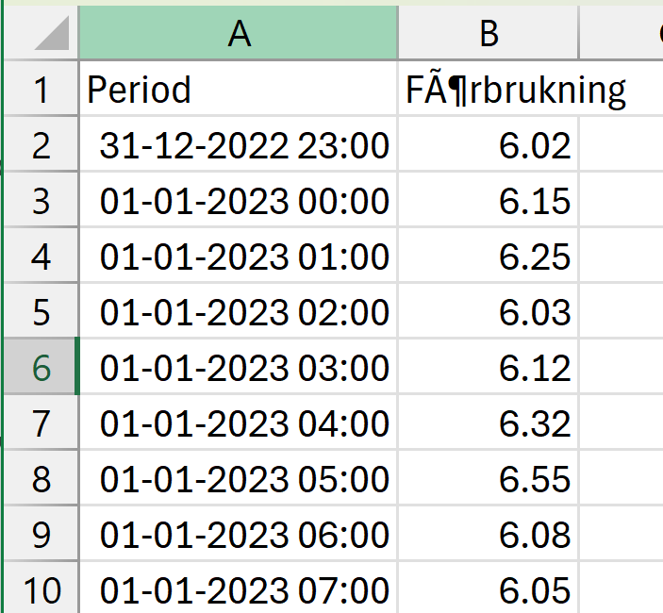
Input

Slide 13
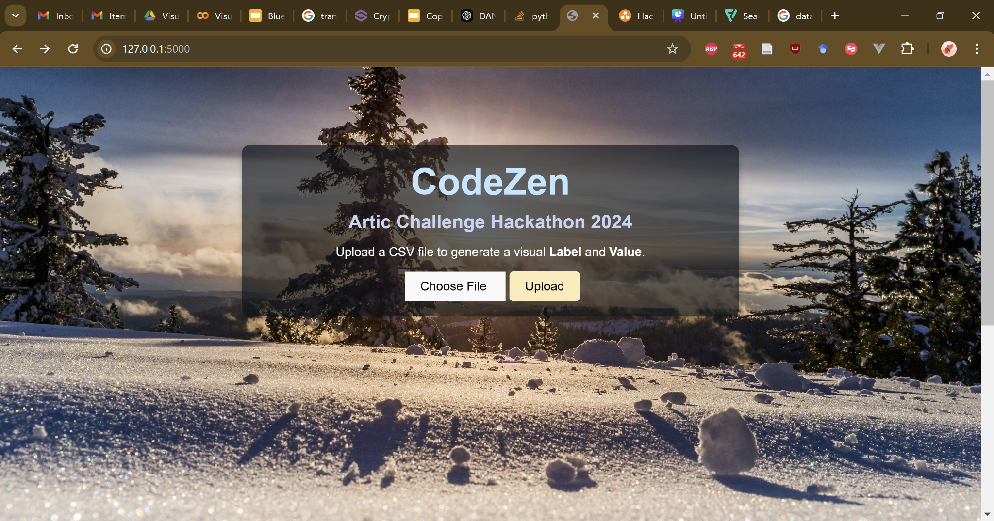

Slide 14
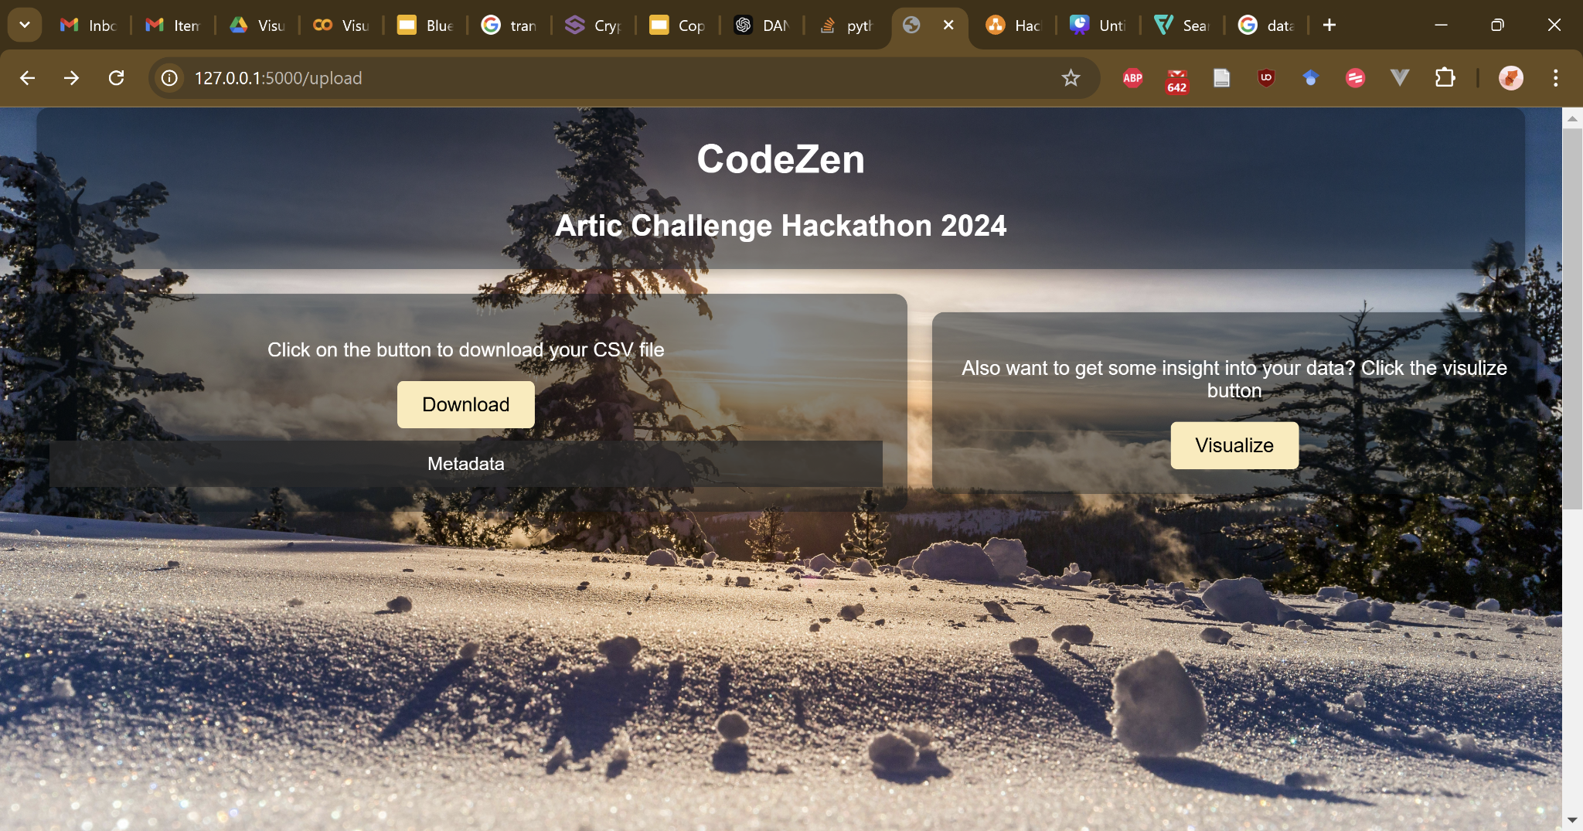

Slide 15
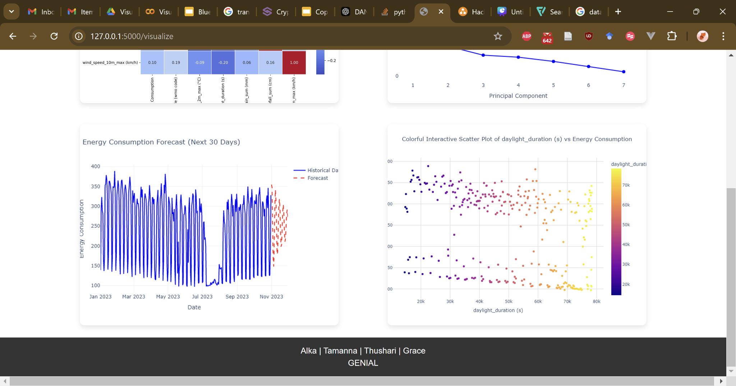

Slide 16
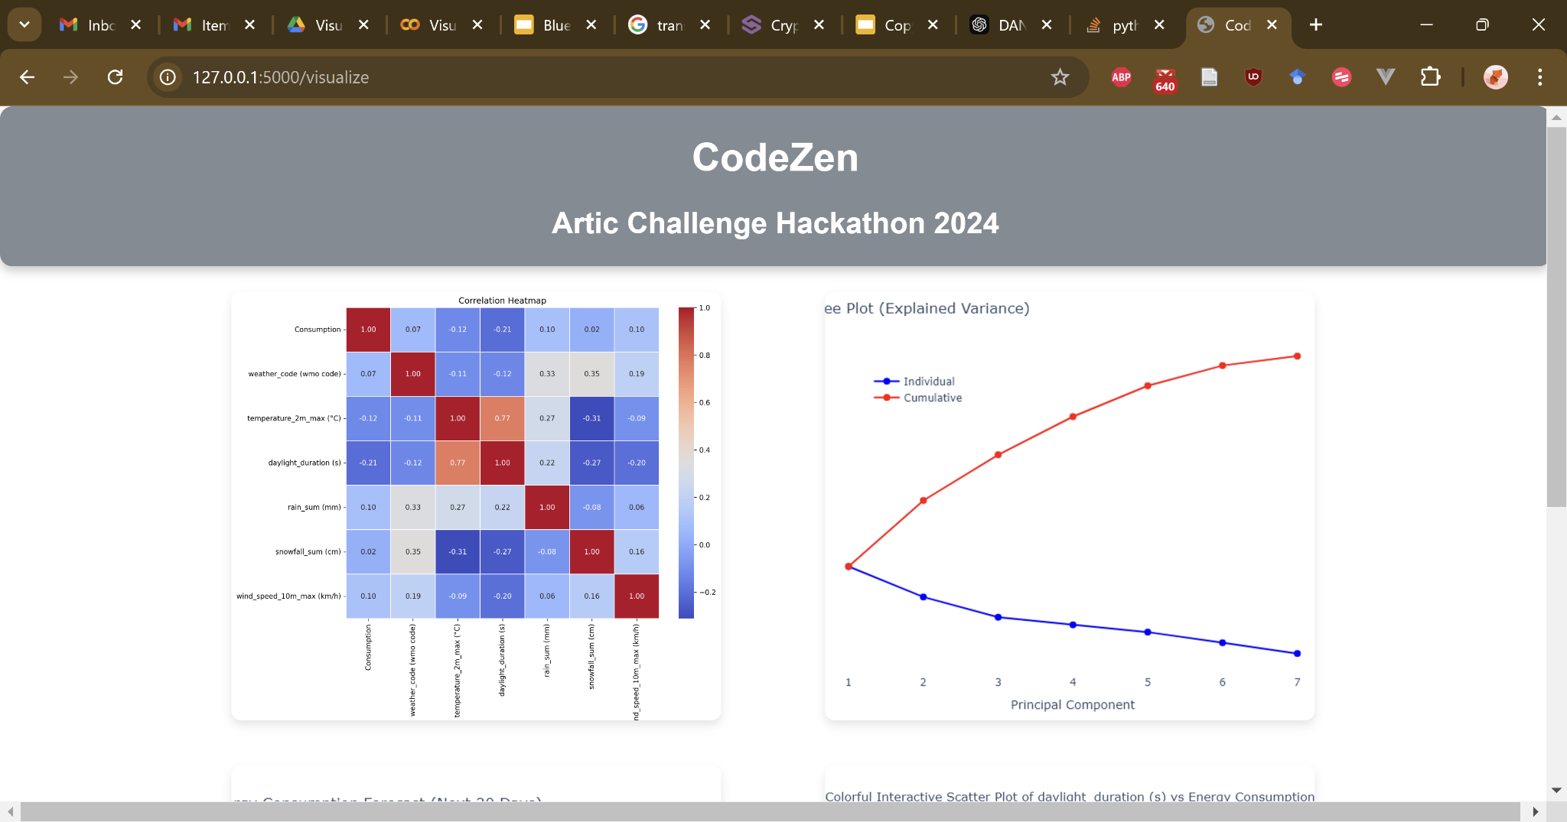

Slide 17
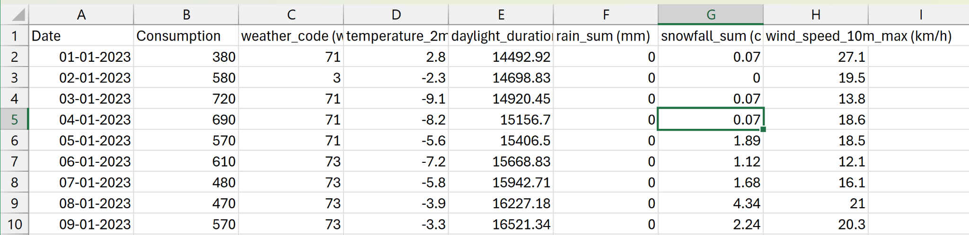
Output

Slide 18




Technologies

Slide 19


Slide 20
Analysis & Insights
Metadata of Processed csv
Date: The date of the record (DD-MM-YYYY).
Consumption: Daily energy consumption (float).
weather_code (wmo code): WMO weather code representing weather conditions (integer).
temperature_2m_max (°C): Max temperature at 2m above ground level (float).
daylight_duration (s): Duration of daylight in seconds (float).
rain_sum (mm): Total rainfall for the day (mm).
snowfall_sum (cm): Total snowfall for the day (cm).
wind_speed_10m_max (km/h): Max wind speed at 10m above ground level (km/h).
Usage: Ideal for forecasting energy consumption and analyzing the impact of weather on energy usage.

Slide 21
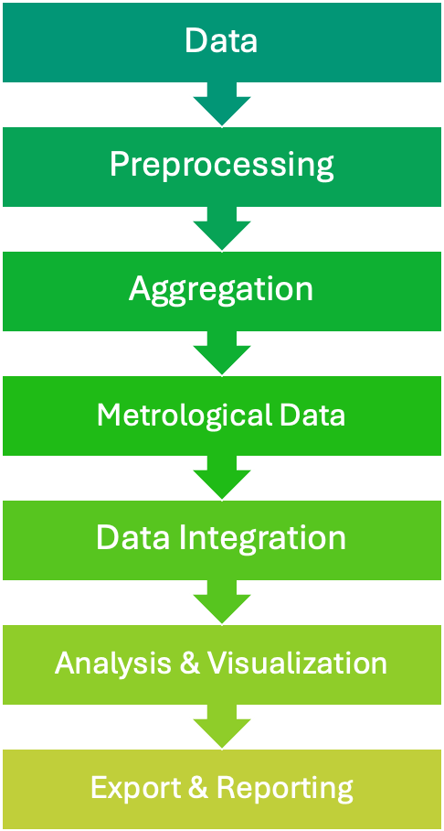

Data Analytics Pipeline

Slide 22
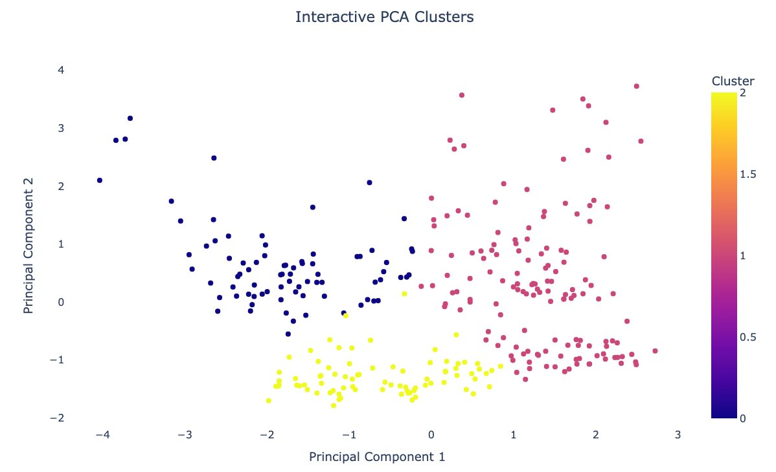
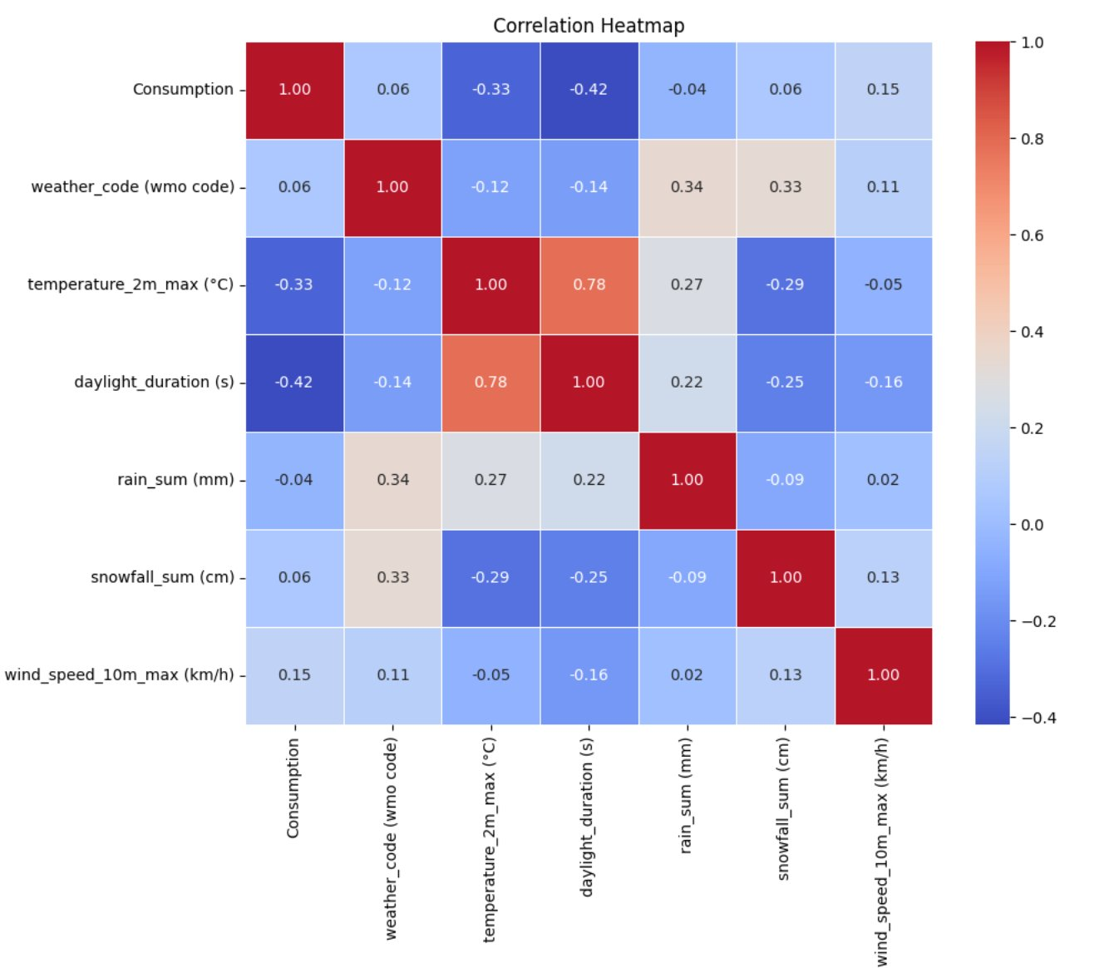
Analytics & Insights
Notes:
PCA and correlation positive-daylight, and correlation

Slide 23
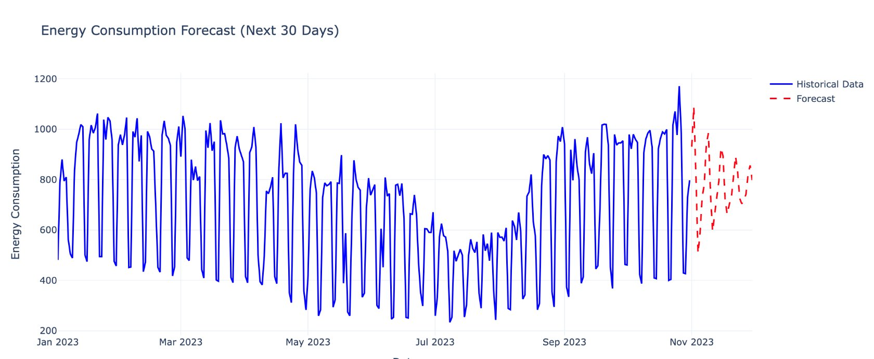
Analytics & Insights
Notes:
energy consumption forecast - upto 30 days

Slide 24
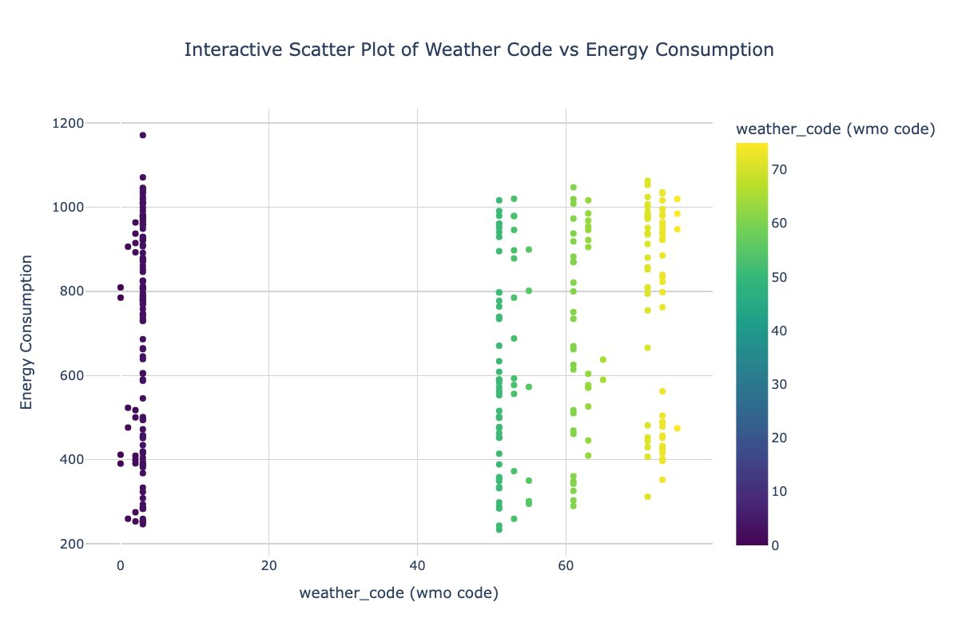
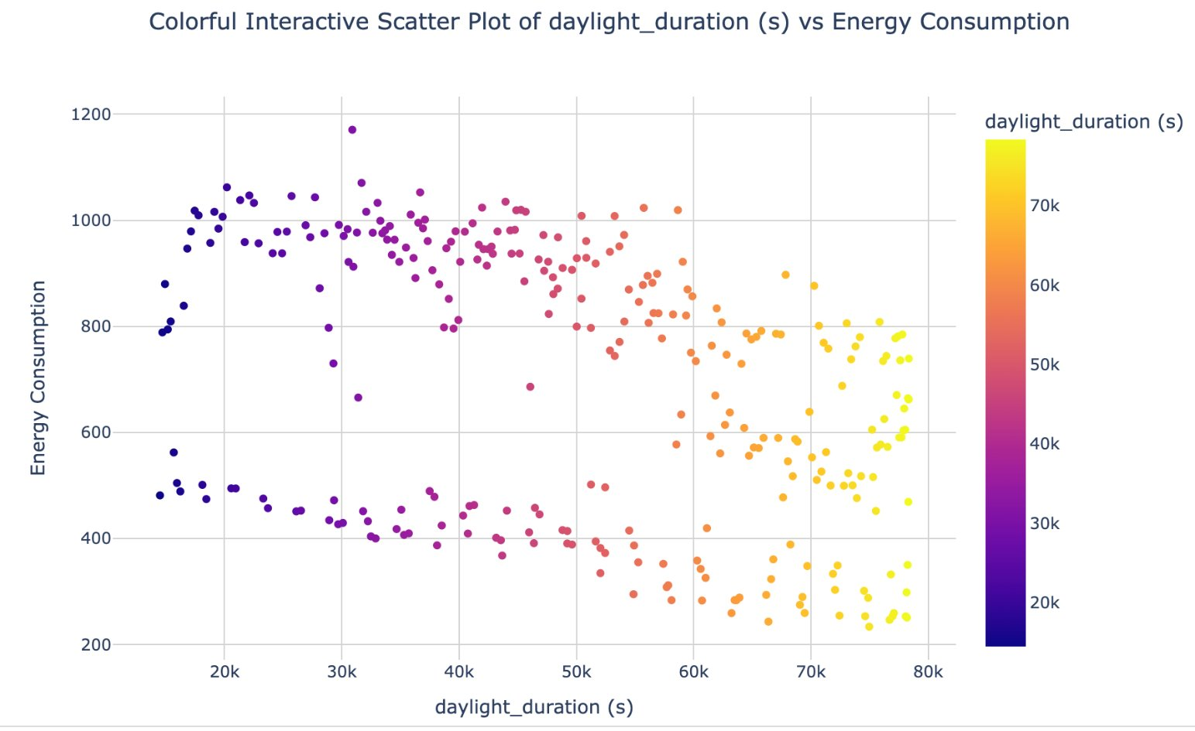
Analytics & Insights

Slide 25

Conclusion & Future Directions
Criteria | What We Achieved | What Lies Ahead?
Visualization | Created a web tool with heatmaps and trend charts highlighting energy patterns | - Add a parser to handle file formats like CSV, JSON, and Excel.
Usefulness | - Standardized unstructured data | - Extend scope to include more metrics, sensor data
 | - Combined geospatial, weather, and building data for insights. | - keyword mapping for better column standardization.
Innovation | - Unified datasets into a standard format for flexibility. | - Add AI-driven models for deeper insights.
 | - modular pipeline for various use cases. | - Add tools for "what-if" scenarios to simulate energy savings.
Business Potential | - actionable insights, simple user interface. | - Develop an API for easy business integration.
 | - scalable, stakeholder-friendly process pipeline. | - Collaborate with energy providers for tailored dashboards.
Dreaming Big:
We can go beyond schools to offices, factories, and maybe even smart cities. The sky (and our CPU) is the limit!

Slide 26
REFERENCES
Reveshti, A. M., Ebrahimpour, A., & Razmara, J. (2023). Investigating the effect of new and old weather data on the energy consumption of buildings affected by global warming in different climates. International Journal of Thermofluids, 19, 100377
Energy performance certificate by Boverket
https://open-meteo.com/en/docs/historical-weather-api
Putting a Number on Bad Data By Salma Bakouk on January 19, 2024, Data Strategy News, Articles, & Education.
https://www.kaggle.com/competitions/widsdatathon2022/overview

Slide 27

Thank You!
Questions?

